Slide 1
CS 3006 Parallel and Distributed Computing Lecture 9
Danyal Farhat
FAST School of Computing
NUCES Lahore

Slide 2
Shared Memory Programming with OpenMP

Slide 3
Outline
Shared Memory Programming
Shared-Memory Programming (Fork/Join Parallelism)
Shared-Memory vs. Message Passing Model
Introduction to OpenMP
OpenMP Solution Stack Model
Implementation using Visual Studio C++
How does OpenMP work?
Pragmas
parallel for Pragma

Slide 4
Outline (Cont.)
Canonical [allowed] Shape of for-loop Condition
Shared and Private Variables
Basic Library Functions
Program Structure
First Program: Hello World
Home Task
Summary
Additional Resources

Slide 5
Shared Memory Programming
Physically: processors in a computer share access to the same RAM
Virtually: threads running on the processors interact with one another via shared variables in the common address space of a single process
Making performance improvements to serial code tends to be easier with multithreading than with message passing paradigm
Message passing usually requires the code/algorithm to be redesigned
Multithreading allows incremental parallelism: take it one loop at a time
Clusters today are commonly made up of multiple processors per compute node; using OpenMP with MPI is a strategy to improve performance at the two levels (i.e. shared and distributed memory)

Slide 6
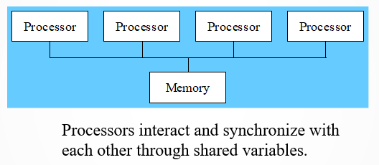
Shared Memory Programming (Cont.)

Slide 7
Shared-Memory Programming (Fork/Join Parallelism)
Multi-threaded programming is the most common shared-memory programming methodology
A serial code begins execution. The process is the master thread or only executing thread
When a parallel portion of the code is reached, the Master thread can “fork” more threads to work on it
When the parallel portion of the code has completed, the threads “join” again, and the master thread continues executing the serial code

Slide 8
Shared-Memory vs. Message Passing Model
Shared-Memory Model
One active thread at start and end of the program
Number of active threads inside program changes dynamically during execution
Supports incremental parallelism
The process of converting a sequential program to a parallel program a little bit at a time
Message-Passing Model
All processes remain active throughout execution of program
Sequential-to-parallel transformation requires major effort
No incremental parallelism
Transformation done in one giant step rather than many tiny steps

Slide 9
Introduction to OpenMP
OpenMP has emerged as a standard method for shared-memory programming
Same as MPI has become the standard for distributed-memory programming
Codes are portable
Performance is usually good enough
Compiler support
C, C++ & Fortran
Intel (icc -openmp), and GNU (gcc -fopenmp)
Notes:
GNU is an operating system.

Slide 10
Introduction to OpenMP (Cont.)
OpenMP (Open Multi Processing) is an API for writing multithreaded applications
Provides an implementation model to distribute and decompose the work across multiple processors
Uses threads to deploy work
Greatly simplifies writing multi-threaded (MT) programs in Fortran, C and C++

Slide 11
Introduction to OpenMP (Cont.)
OpenMP is described by the API based on:
A set of compiler directives for depicting the parallelism in the source code
A library of subroutines
A set of Environment Variables
OpenMP directives in C and C++ are based on the #pragma compiler directives
Works on the basis of Fork-Join model

Slide 12
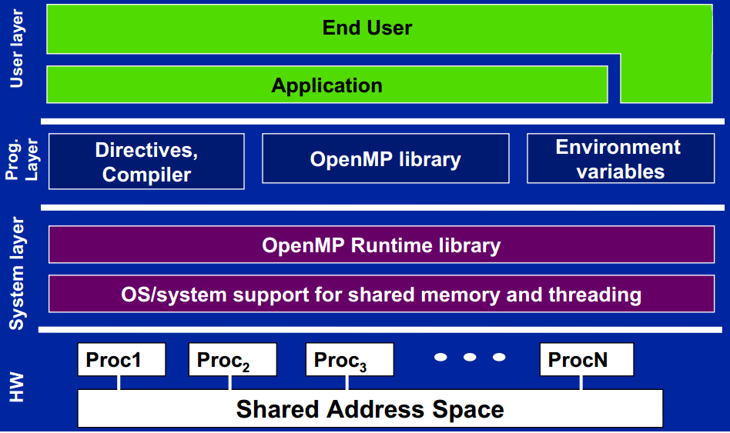
OpenMP Solution Stack Model
Source: http://openmp.org/mp-documents/omp-hands-on-SC08.pdf

Slide 13
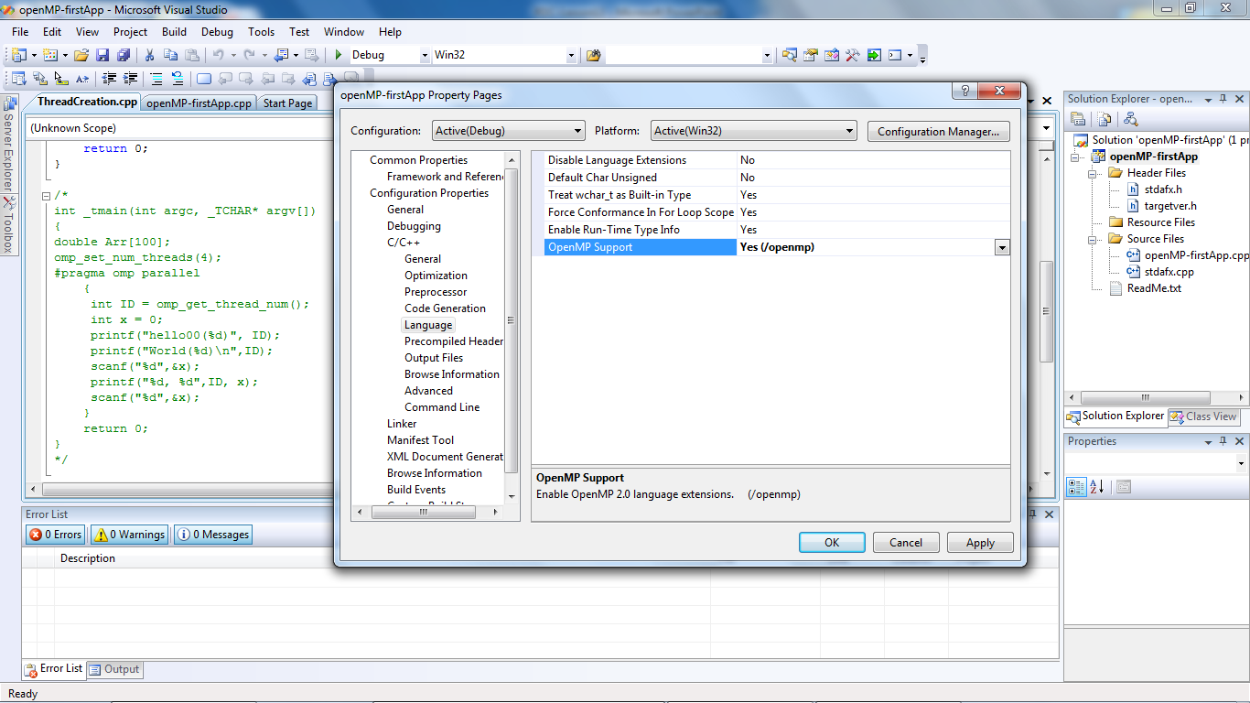
Implementation using Visual Studio C++
Turn on OpneMP support in Visual Studio
Project properties → Configuration → C/C++/Language

Slide 14
How does OpenMP work?
C programs often express data-parallel operations as for loops
for (i = first; i < size; i += 2)
marked[i] = 1;
OpenMP makes it easy to indicate when the iterations of a loop may execute in parallel
Compiler takes care of generating code that forks/joins threads and allocates the iterations to threads

Slide 15
How does OpenMP work? - Pragmas
Pragma: a compiler directive in C or C++
Stands for “pragmatic information”
Pragmatic information : practical information, realistic insight
A way for the programmer to communicate with the compiler
Compiler is free to ignore pragmas
Syntax:
#pragma omp <rest of pragma>
The pragmas precede the regions that can be parallelize to flag the compiler that performing operations in parallel does not affect the program semantics (i.e., doesn’t affect the program’s logic).

Slide 16
How does OpenMP work? - parallel for Pragma
Format:
#pragma omp parallel for
for (i = 0; i < N; i++)
a[i] = b[i] + c[i];
Compiler must be able to verify total number of iteration before executing the program, to parallelize it
Body of for-loop must not allow premature exits (e.g., break, return, exit, or goto statements are not allowed)
However, loops with ‘continue’ statement are allowed as it does not cause the premature exit

Slide 17
Canonical [allowed] Shape of for-loop Condition
Canonical shape: allowed shape, traditional shape, according to rules
Here ‘inc’ can be any constant value

Slide 18
Shared and Private Variables
Shared Variable:
Has same address in execution context of every thread
Private Variable:
Has different address in execution context of every thread
A thread cannot access the private variables of another thread

Slide 19
Basic Library Functions
omp_get_num_procs
int procs = omp_get_num_procs()
//number of CPUs/cores in machine
omp_get_num_threads
int threads = omp_get_num_threads()
//number of active threads
//should be called from a parallel region
omp_get_max_threads
printf(“Only %d threads can be forked\n",omp_get_max_threads());
//can be called outside of a parallel region

Slide 20
Basic Library Functions (Cont.)
omp_get_thread_num
printf("Hello from thread id %d\n",omp_get_thread_num());
// return thread id
omp_set_num_threads
omp_set_dynamic(0); // disable dynamic adjustment
omp_set_num_threads(4); //setting thread count to 4

Slide 21
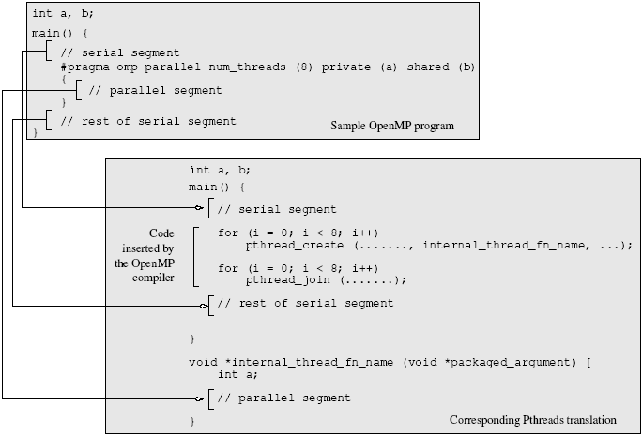
Program Structure
Source: Introduction to Parallel Computing (Karypis and Co.)

Slide 22
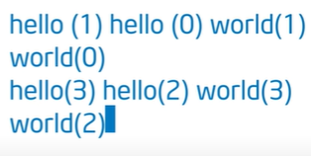
First Program: Hello World
#include <omp.h>
#include <iostream>
using namespace std;
int main()
{
omp_set_num_threads(4);
#pragma omp parallel
{
int Id = omp_get_thread_num();
Printf (“hello(%d)”, Id);
printf (“world(%d)\n”, Id)
}
}
Runtime function to request a certain number of threads
Runtime function returning a thread ID
Notes:
Runtime function returning a thread ID = Unique identifier for each thread

Slide 23
First Program: Hello World – 2nd Example
#include <omp.h>
int numT;
int main()
{
#pragma omp parallel num_threads(4)
{
int Id = omp_get_thread_num();
numT = omp_get_num_threads();
Printf (“hello(%d)”, Id);
printf (“world(%d)\n”, Id)
}
}
Clause to request a certain number of threads
Runtime function
returning no. of threads actually created

Slide 24
Home Task
Write an OpenMP program that should create 2 threads to run in parallel and display thread id of each created thread.

Slide 25
Summary
Shared Memory Programming
Processors share RAM, Threads share variables
Performance improvement is easier with multithreading than with message passing paradigm
Shared-Memory Programming (Fork/Join Parallelism)
Using "fork", master thread creates worker threads
Using "join", worker threads return to the master thread
Shared-Memory vs. Message Passing Model
Shared-Memory Model: One active thread at start and end of program, incremental parallelism
Message-Passing Model: All processors remain active throughout execution of program, no incremental parallelism

Slide 26
Summary (Cont.)
Introduction to Open Multi Processing (OpenMP)
OpenMP is an API for writing multithreaded applications
OpenMP is described by the API based on:
A set of compiler directives for depicting the parallelism in the source code
A library of subroutines
A set of Environment Variables
OpenMP Solution Stack Model
Implementation using Visual Studio C++
How does OpenMP work?
C programs often express data-parallel operations as for loops
OpenMP makes it easy to indicate when the iterations of a loop may execute in parallel

Slide 27
Summary (Cont.)
Pragmas
A compiler directive in C or C++
A way for the programmer to communicate with the compiler
parallel for Pragma
Canonical [allowed] Shape of for-loop Condition
Shared and Private Variables
Shared Variable: Has same address in execution context of every thread
Private Variable: Has different address in execution context of every thread

Slide 28
Summary (Cont.)
Basic Library Functions
omp_get_num_procs
omp_get_num_threads
omp_get_max_threads
omp_get_thread_num
omp_set_num_threads
Program Structure
First Program: Hello World
Home Task

Slide 29
Additional Resources
Book: Introduction to Parallel Computing by Ananth Grama and Anshul Gupta
Chapter 7: Programming Shared Address Space Platforms
Introduction to OpenMP by Tim Mattson (Intel)
https://www.youtube.com/watch?v=nE-xN4Bf8XI&list=PLLX-Q6B8xqZ8n8bwjGdzBJ25X2utwnoEG&index=1

Slide 30
Questions?

